Slide 1
Day 4: OpenShift Advanced Topics
Kubernetes Operators & OLM
Application Security
CronJobs
OpenShift Updates

Slide 2
Agenda
Operators & OLM
Installing Operators
Managing Operators
Security (SCC, RBAC)
CronJobs
OpenShift Updates
Hands-on Labs

Slide 3
What is an Operator?
Kubernetes-native automation
Extends Kubernetes using CRDs
Automates install, scale, backup, recovery

Slide 4
Why Operators?
Manual setup → errors
Operators → automated lifecycle
Self-healing and consistent deployment

Slide 5
Operator Lifecycle Manager (OLM)
Manages install, upgrade, permissions
Components:
- Subscription
- InstallPlan
- CSV

Slide 6
OLM Flow
Catalog → Subscription → InstallPlan → CSV → Running Operator

Slide 7
Hands-on: View Operators
oc get operators -A
oc get csv -A
oc get catalogsource -n openshift-marketplace

Slide 8


Install Operator (Web Console)
OperatorHub → Select → Install
Choose namespace
Approve installation

Slide 9
Install Operator (CLI)
Create
Create Namespace
Create
Create OperatorGroup
Create
Create Subscription

Slide 10
Managing Operators
Upgrade, Monitor, Troubleshoot
oc get subscription
oc get installplan

Slide 11
Security Context Constraints (SCC)
Controls container permissions
Types:
- restricted
- anyuid
- privileged

Slide 12

Hands-on: SCC
oc get scc
oc describe scc restricted

Slide 13
Fix SCC Issues
oc adm policy add-scc-to-user anyuid -z default

Slide 14
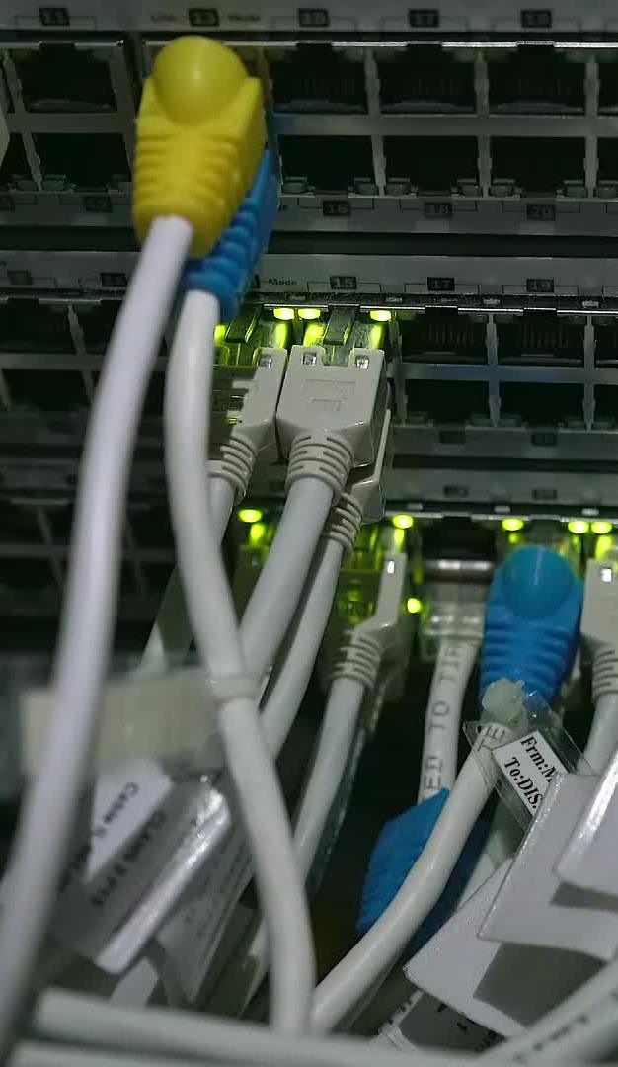
RBAC & API Access
ServiceAccount + Role + RoleBinding
Controls pod access to API

Slide 15
CronJobs
Used for backups, cleanup, maintenance

Slide 16

Hands-on: CronJob
Create cronjob yaml
oc apply -f cronjob.yaml
oc get jobs

Slide 17
OpenShift Updates
Managed by Cluster Version Operator
oc get clusterversion

Slide 18
Operator Updates
Handled via Subscription
oc get subscription -A

Slide 19

Deprecated API Detection
oc get apirequests -A

Slide 20
End-to-End Lab
Install operator
Verify CSV
Assign SCC
Create CronJob
Check version

Slide 21
Common Issues
Operator stuck → check InstallPlan
Pod fails → SCC issue
CronJob not running → schedule
Upgrade fails → deprecated APIs

